Slide 1
Chapter 5 Trees（树）
Notes:
树

Slide 2
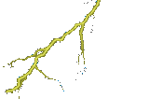
















Notes:
Trees are a very useful data structure. Many different kinds of trees are used in Computer Science. We shall study just a few of these.

Slide 3
Nature Lover’s View Of A Tree
leaves
branches
root
Notes:
自然界中树的结构

Slide 4

Computer Scientist’s View
root
leaves
branches
nodes
Notes:
Branches meet at nodes.（分支交汇于节点）
计算机科学中的树

Slide 5















5.1 Introduction
5.1.1. Terminology
Pedigree Tree
( binary tree )
Lineal Tree

Slide 6
【Definition】A tree (树) is a finite set of zero or more nodes such that:
(1) There is a specially designed node called the root (根).
(2) The remaining nodes are partitioned into n ≥ 0 disjoint
sets T₁, ⋅⋅⋅, T_{n}, where each of these sets is a tree. We call
T₁, ⋅⋅⋅, T_{n} the subtrees (子树) of the root.
root
T₁
A
T₂
B
T₃
C
T₄
D
E
F
G
H
I
J
Note:
➢ Subtrees must not connect together. Therefore every node in the tree is the root of some subtree.
➢ Trees in this book are all directed trees(有向树). Normally the root is drawn at the top.
Notes:
树是依个包含零个或多个节点的有限集合，满足：
一个特殊的节点，称为 根
(2)其余的节点被分为n（n≥0）个不相交的集合T1, … Tn，每一个集合都是一棵树。这样的T1…Tn被称为根节点的子树。
注意：
子树之间一定不相连，因此树中的每一个节点都是某个子树的根节点
本课程中，树都是指有向树。一般根画在最上面。

Slide 7
Hierarchical Data And Trees
The element at the top of the hierarchy is the root.
Elements next in the hierarchy are the children of the root.
Elements next in the hierarchy are the grandchildren of the root, and so on.
Elements that have no children are leaves (叶, leaf).
Notes:
层次化数据和树
层次结构的顶部是 根
层次结构中下一层的节点成为根的子节点。
再下一层的节点称为孙节点，以此类推。
没有子节点的节点称为叶节点。

Slide 8
Example Tree
President
root
children of root
VP1
VP2
VP3
Manager1
Manager2
Manager
Manager
grand children of root
Worker Bee
great grand child of root

Slide 9
Subtrees
President
root
VP1
VP2
VP3
Manager1
Manager2
Manager
Manager
Worker Bee
Notes:
子树

Slide 10
Leaves
President
VP1
VP2
VP3
Manager1
Manager2
Manager
Manager
Worker Bee
Notes:
叶节点

Slide 11
Parent, Grandparent, Siblings, Ancestors, Descendants
President
VP1
VP2
VP3
Manager1
Manager2
Manager
Manager
Worker Bee
Notes:
父节点、祖父节点、兄弟节点、祖先、后代

Slide 12
Levels
President
Level 1
Level 2
VP1
VP2
VP3
Manager1
Manager2
Manager
Manager
Level 3
Worker Bee
Level 4
Notes:
层次

Slide 13
Caution
Some texts start level numbers at 0 rather than at 1.
Root is at level 0.
Its children are at level 1.
The grand children of the root are at level 2.
And so on.
We shall number levels with the root at level 1.
Notes:
注意，有些书籍中把根节点视为第0层，本课程中统一将根节点视为第一层。

Slide 14
height = depth = number of levels
President
Level 1
Level 2
VP1
VP2
VP3
Manager1
Manager2
Manager
Manager
Level 3
Worker Bee
Level 4
Notes:
高度、深度：即层次数

Slide 15
Node Degree = Number Of Children
President
3
2
VP1
1
VP2
1
VP3
0
0
1
0
Manager1
Manager2
Manager
Manager
Worker Bee
0
Notes:
节点的度：子节点（子树）的个数

Slide 16
Tree Degree = Max Node Degree
President
3
2
VP1
1
VP2
1
VP3
0
0
1
0
Manager1
Manager2
Manager
Manager
Worker Bee
0
Degree of tree = 3.
Notes:
树的度：最大的节点度
Note that it is possible to have a tree whose degree is (say) 3 and whose root has a
degree that is < 3.
注意：有可能树的度为3但根的度小于3

Slide 17

Some Definitions
 level ::= level( parent ) + 1; level( root ) = 1.
 height ( depth ) ::= max { levels }.
 parent ::= a node that has subtrees.
 children ::= the roots of the subtrees of a parent.
 siblings ::= children of the same parent.
 ancestors of a node ::= all the nodes along the path from the node up to the root.
 descendants of a node ::= all the nodes in its subtrees.
 degree of a node ::= number of subtrees of the node. For example, degree(A) = 3, degree(F) = 0.
Level
A
1
 degree of a tree ::=
For example, degree of this tree = 3.
B
C
D
2
E
F
G
H
I
J
3
 leaf ( terminal node ) ::= a node with degree 0.
K
L
M
4

Slide 18

5.1. Introduction
5.1.2. Representation
❖ List Representation
A
( A )
B
C
D
( A ( B, C, D ) )
E
F
G
H
I
J
( A ( B ( E, F ), C ( G ), D ( H, I, J ) ) )
K
L
M
( A ( B ( E ( K, L ), F ), C ( G ), D ( H ( M ), I, J ) ) )
So the size of each node
depends on the number of
branches.
Hmmm... That’s not good.
E
K
B
L
F
A
C
G
H
M
D
I
J
Notes:
树的表达

Slide 19
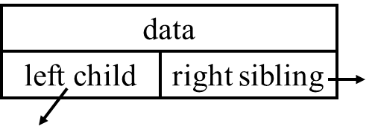
❖ Left Child-Right Sibling Representation
A
N
B
C
D
A
N
B
C
D
E
F
G
H
I
J
E
F
G
H
I
J
N
N
N
N
N
N
N
K
L
M
K
L
M
N
N
N
N
N
Note: The representation is not unique since the children in a tree can be of any order.
Notes:
左子右兄弟的表达方法：
两个指针，左指针指向子节点(left child)，右指针指向兄弟节点(right sibling)。
注意：这种表达不是唯一的，因为树的子节点之间没有顺序关系

Slide 20
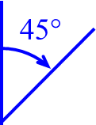
❖ Representation as a Degree 2 Tree :
Rotate the left child-right sibling tree clockwise by 45°.
A
N
A
N
B
Its right child
is always empty
B
C
D
N
E
E
F
G
H
I
J
N
K
F
C
N
N
N
N
N
N
N
N
N
N
L
G
N
N
D
K
L
M
N
N
N
N
N
N
N
H
data
M
N
I
N
N
left child
right child
left child
N
J
N
type struct TreeNode *PtrToNode;
struct TreeNode
{
ElementType Element;
PtrToNode Left;
PtrToNode Right;
};
right child
A Binary Tree
Notes:
2度树的表达
将左子右兄弟的树顺时针转45度，得到二叉树(Binary Tree)

Slide 21
parent
Data
A
0
1
2
3
4
5
6
A | -1
B | 0
C | 0
D | 0
E | 2
F | 2
G | 5
B
D
C
E
F
G
root=0
N =7
双亲表示

Slide 22
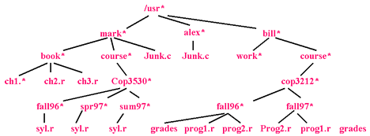
❖ Directory structure in many common operating systems
Each / after the first indicates an edge; the result is the full pathname.
Hierarchical file system is very popular, directory in the unix file system is just a file with a list of all its children.
Notes:
树的应用举例：
常用操作系统中的目录结构。
每个/符号表示树中的一条边，结果就是完整的路径。
层次化的文件结构是非常普遍的，unix文件系统中的目录和文件一样

Slide 23
5.2 Binary Tree
Finite (possibly empty) collection of elements.
A nonempty binary tree has a root element.
The remaining elements (if any) are partitioned into two binary trees.
These are called the left and right subtrees of the binary tree.
Notes:
5.2. 二叉树
有限个元素（可以为空）
非空的二叉树有一个根节点
其余节点（如果存在）被分为两个二叉树
这两个二叉树分别称为原二叉树的左子树和右子树

Slide 24
Differences Between A Tree & A Binary Tree
No node in a binary tree may have a degree more than 2, whereas there is no limit on the degree of a node in a tree.
A binary tree may be empty; a tree cannot be empty.
Notes:
普通树和二叉树的区别：
二叉树中每个节点的度都不大于2，而普通树中，节点的度则没有限制。
二叉树可以为空，但普通的树通常不能为空（偶尔也有允许为空的情况）

Slide 25

5.2.1 ADT Definition
structure Binary_Tree is
objects: A finite set of nodes either empty or consisting of a root node, left Binary_Tree, and right Binary_Tree.
functions:
for all bt, bt1, bt2 ∈ Binary_Tree, item ∈ element
Binary_Tree Create ( )
::= creates an empty binary tree
Boolean IsEmpty ( bt )
::= if ( bt = = empty binary tree ) return TRUE
else return FALSE
Binary_Tree MakeBT ( bt1, item, bt2 )
::= return a binary tree whose left subtree is bt1, whose right subtree is bt2, and whose root node contains the data item.
Notes:
树的抽象数据类型

Slide 26
§2 Binary Trees
structure Binary_Tree is ( continued )
functions:
Binary_Tree Lchild ( bt ) ::= if ( IsEmpty( bt ) ) return error
else return the left subtree of bt.
Element Data ( bt ) ::= if ( IsEmpty ( bt ) ) return error
else return the data in the root
node of bt.
Binary_Tree Rchild ( bt ) ::= if ( IsEmpty( bt ) ) return error
else return the right subtree of bt.
end Binary_Tree
Note:
➢ In a tree, the order of children does not matter. But in a binary tree, left child and right child are different.
A
A
and
are two different binary trees.
B
B
Notes:
注意：
在树中，子节点的顺序是无关的，但是在二叉树中，左子节点和右子节点是不同的

Slide 27
§2 Binary Trees
Skewed Binary Trees
Complete Binary Trees
A
A
A
B
B
B
C
C
C
D
E
F
G
D
D
H
I
Skewed to the left
Skewed to the right
All the leaf nodes are on two
adjacent levels
5.2.2. Properties of Binary Trees
☑ The maximum number of nodes on level i is 2 ^{i−1}, i ≥ 1.
The maximum number of nodes in a binary tree of depth k is
2 ^{k} − 1, k ≥ 1.
Proof: By induction.
Notes:
偏向(Skewed)二叉树和完全(Complete)二叉树
二叉树的性质：
第i层中节点数最大为2^(i-1), 深度为k的二叉树中节点综述最大为2^k – 1.
可以用数学归纳法证明

Slide 28

§2 Binary Trees
☑ For any nonempty binary tree, n₀ = n₂ + 1 where n₀ is the number of leaf nodes and n₂ the number of nodes of degree 2.
Proof: Let n₁ be the number of nodes of degree 1, and n the total number of nodes. Then
n =
1
1
2
3
n = B + 1.
Let B be the number of branches. Then n ~ B?
2
4
5
6
7
Since all branches come out of nodes of degree 1 or 2, we have B ~ n₁ & n₂ ?
B = n₁ + 2 n₂.
3
8
9
10
11
12
13
14
15
⇒ n₀ = n₂ + 1
☑ A full binary tree of depth k is a binary tree of depth k having 2 ^{k} − 1 nodes, k ≥ 0 .
☑ A binary tree with n nodes and depth k is complete iff its nodes correspond to the nodes numbered from 1 to n in the full binary tree of depth k.
Notes:
对于任意一个非空的二叉树，叶节点的个数等于度为2 的节点个数加1。
K层的满（full）二叉树有2^k-1个节点。
一个包含n个节点的k层二叉树是完全二叉树当且仅当(iff)它的节点对应k层满二叉树中标号为1到n的节点。

Slide 29


5.2 Binary Trees
5.2.3. Binary Tree Representations
❖ Array Representation : BT [ n + 1 ] ( BT [ 0 ] is not used)
【Lemma】If a complete binary tree with n nodes (depth = ⎣ log₂ n + 1 ⎦ ) is represented sequentially, then for any node with index i, 1 ≤ i ≤ n, we have:
1
2
Oops!
Here comes the picky guy.
What’s wrong with this
representation eh?
3
Tell me,
how large must the array be
to store a BT of depth 10?
Gee! Then only
10 spaces are occupied.
Okay, you’ve
made your point.
4
5
6
1024.
7
What if the BT is skewed?
8
9
10
11
12
13
14
15
Proof: By induction.
Notes:
二叉树的表示：
数组表示：BT[n+1],其中BT[0]不使用
N个节点的完全二叉树中（以下都假设相应节点存在），第i个节点的父节点下标为i/2,左子节点为i*2, 右子节点为i*2+1

Slide 30
例如
0
A
2
D
1
B
6
E
4
C
F
13
0 | 1 | 2 | 3 | 4 | 5 | 6 | 7 | 8 | 9 | 10 | 11 | 12 | 13 | 14 | 15
 | A | B | D |  | C |  | E |  |  |  |  |  |  | F

Slide 31
Linked Representation Example
root
a
b
c
e
d
g
f
leftChild
data
h
rightChild
Notes:
二叉树的链表表示

Slide 32
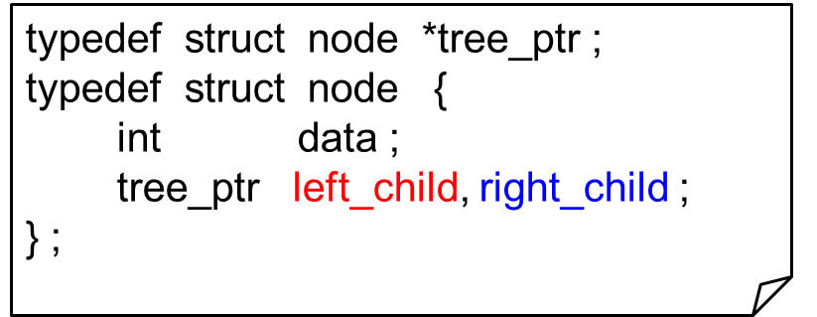
5.2 Binary Trees
5.2.3.2 Linked Representation
data
left child
right child
Should we need to know the parents of random nodes, we will add a 4th field, parent, to the node definition.
typedef struct node *tree_ptr ;
typedef struct node {
int data ;
tree_ptr left_child, right_child ;
tree_ptr parent ;
} ;
parent
data
left child
right child
Notes:
链表表达
可以加上第四个字段：父节点，便于查找父节点

Slide 33
5.3 Binary Tree Traversal
Many binary tree operations are done by performing a traversal of the binary tree.
In a traversal, each element of the binary tree is visited exactly once.
During the visit of an element, all action (make a clone, display, evaluate the operator, etc.) with respect to this element is taken.
Notes:
5.3. 二叉树的遍历(Traversal)
许多二叉树操作都需要对二叉树进行遍历
在遍历过程中，树中的每个节点仅被访问一次
在访问过程中，对相应节点的所有操作都可以同时完成

Slide 34
Binary Tree Traversal Methods
Preorder
Inorder
Postorder
Level order
Notes:
二叉树遍历的方法：
前序（先序）遍历
中序遍历
后序遍历
按层遍历

Slide 35
5.3. Binary Tree Traversals
—— visit each node exactly once
L ::= move left ; R ::= move right ; V ::= visit the node.
We will always traverse the left subtree before the right one ⇒ LVR、 LRV、 VLR
Inorder
traversal
Postorder
traversal
Preorder
traversal
〖Example〗 Given a syntax tree of an expression (infix)
A + B ∗ C / D
+
Then LVR ⇒ A + B ∗ C / D
LRV ⇒ A B C ∗ D / +
VLR ⇒ + A / ∗ B C D
A
/
∗
D
B
C
Notes:
二叉树的遍历

Slide 36
§3 Binary Tree Traversals
❖ Inorder Traversal
Algorithm
Step 1 : move down along the left path untill NULL is reached;
Step 2 : visit\print the parent node;
Step 3 : if ( parent has a right child ) {
move to the right node;
repeat steps 1 to 3; }
else {
move to the next higher level until
the parent of the current node has
been visited;
repeat steps 2 to 3; }
+
A
/
∗
D
B
C
Iterative Program
void iter_inorder ( tree_ptr node )
{ int top = −1; /* initialize stack */
tree_ptr stack [ MAX_STACK_SIZE ];
for ( ; ; ) {
for ( ; node; node = node->left_child )
push ( &top, node ) ;
node = pop ( &top );
if ( !node ) break;
printf ( “ %d”, node->data );
node = node->right_child; }
}
Recursive Program
void inorder ( tree_ptr ptr )
{ if ( ptr ) {
inorder ( ptr->left_child );
printf ( “ %d”, ptr->data );
inorder ( ptr->right_child );
}
}
T_{p} = O( n )
Notes:
中序遍历算法、迭代(iterative)实现和递归(recursive)实现

Slide 37

❖ Preorder Traversal
❖ Postorder Traversal
void preorder ( tree_ptr ptr )
{ if ( ptr ) {
printf ( “ %d”, ptr->data );
preorder ( ptr->left_child );
preorder ( ptr->right_child );
}
}
void postorder ( tree_ptr ptr )
{ if ( ptr ) {
postorder ( ptr->left_child );
postorder ( ptr->right_child );
printf ( “ %d”, ptr->data );
}
}
❖ Level Order Traversal
—— output nodes in the order as they are numbered
Algorithm
Step 1 : push the root onto queue;
Step 2 : pop \ print one node from queue ;
Step 3 : push the left, then the right child of this node onto queue (if it is impossible, then simply continue);
Step 4 : Repeat steps 2 to 3 until queue is empty.
1
1
2
3
4
2
3
5
6
7
4
5
6
7
1
2
3
4
5
6
7
Notes:
前序遍历、后续遍历程序
按层遍历算法（用队列实现）

Slide 38
§3 Binary Tree Traversals
Program
void level_order ( tree_ptr ptr )
{ /* level order tree traversal */
int front = rear = 0 ;
tree_ptr queue [ MAX_QUEUE_SIZE ] ;
if ( !ptr ) return ; /* empty tree */
pushq ( front, &rear, ptr ) ; /* push the root onto queue */
for ( ; ; ) {
ptr = popq ( &front, rear ) ; /* pop one node from queue */
if ( ptr ) {
printf ( “ %d”, ptr->data ) ;
if ( ptr->left_child ) /* if left child is not NULL */
pushq ( front, &rear, ptr->left_child ); /* then push it onto queue */
if ( ptr->right_child ) /* if right child is not NULL */
pushq ( front, &rear, ptr->right_child ); /* then push it onto queue */
} /* end if (ptr) */
else break ; /* if queue is empty, then finish */
} /* end for-loop */
}
Can you eliminate it?
Notes:
按层遍历的代码

Slide 39
Binary Tree Construction
Suppose that the elements in a binary tree are distinct.
Can you construct the binary tree from which a given traversal sequence came?
When a traversal sequence has more than one element, the binary tree is not uniquely defined.
Therefore, the tree from which the sequence was obtained cannot be reconstructed uniquely.
Notes:
二叉树的构建
假设二叉树中所有元素都不同，能否通过一个给定的遍历序列恢复出二叉树？
当遍历序列包含多于一个元素时，二叉树是不唯一的。
因此通过单一的遍历序列无法唯一的构建一个二叉树

Slide 40
Some Examples
preorder = ab
a
a
b
b
inorder = ab
b
a
a
b
postorder = ab
b
b
a
a
level order = ab
a
a
b
b
Notes:
单一序列对应的二叉树不唯一的例子

Slide 41
Binary Tree Construction
Can you construct the binary tree, given two traversal sequences?
Depends on which two sequences are given.
Notes:
二叉树的构建
能否通过两个遍历序列构建二叉树？
取决于给定的是哪两个 遍历序列

Slide 42
Preorder And Postorder
preorder = ab
a
a
postorder = ba
b
b
Preorder and postorder do not uniquely define a binary tree.
Nor do preorder and level order (same example).
Nor do postorder and level order (same example).
Notes:
前序和后序
前序和按层
后序和按层
以上三种都无法唯一得到二叉树

Slide 43
Inorder And Preorder
inorder = g d h b e i a f j c
preorder = a b d g h e i c f j
Scan the preorder left to right using the inorder to separate left and right subtrees.
a is the root of the tree; gdhbei are in the left subtree; fjc are in the right subtree.
a
gdhbei
fjc
Notes:
中序和前序
扫描前序序列，使用中序序列区分左子树和右子树
例如，a是树的根节点(preorder里可以看到), gdhbei和fjc分别是左子树和右子树(根据inorder)

Slide 44
Inorder And Preorder
a
gdhbei
fjc
preorder = a b d g h e i c f j
b is the next root; gdh are in the left subtree; ei are in the right subtree.
a
b
fjc
gdh
ei
Notes:
中序和前序

Slide 45
Inorder And Preorder
a
b
fjc
gdh
ei
preorder = d g h e i c f j
d is the next root; g is in the left subtree; h is in the right subtree.
a
b
fjc
d
ei
g
h
Notes:
中序和前序

Slide 46
Inorder And Postorder
Scan postorder from right to left using inorder to separate left and right subtrees.
inorder = g d h b e i a f j c
postorder = g h d i e b j f c a
Tree root is a; gdhbei are in left subtree; fjc are in right subtree.
Notes:
中序和后序
从右到左扫描后续序列，使用中序区分左子树和右子树

Slide 47
Inorder And Level Order
Scan level order from left to right using inorder to separate left and right subtrees.
inorder = g d h b e i a f j c
level order = a b c d e f g h i j
Tree root is a; gdhbei are in left subtree; fjc are in right subtree.
Notes:
中序和按层
扫描按层序列，使用中序区分左子树和右子树。

Slide 48
5.4 Additional Binary Tree Operations
❖ Copying Binary Trees: LRV where V ::= copy
( Program 5.6 on p.212 )
❖ Testing for Equality of Binary Trees:
VLR where V ::= test ( Program 5.7 on p.213 )
Read the two programs in the textbook
and think:
Is there any particular reason
to choose one order
over the others for the tasks?
Notes:
二叉树的其他操作
复制二叉树
判断二叉树是否相同

Slide 49

5.7 Binary Search Trees
【Definition】A binary search tree is a binary tree. It may be empty. If it is not empty, it satisfies the following properties:
(1) Every node has exactly one key, and the keys are unique.
(2) The keys in a nonempty left subtree must be smaller than the key in the root of the subtree.
(3) The keys in a nonempty right subtree must be larger than the key in the root of the subtree.
(4) The left and right subtrees are also binary search trees.
30
60
20
5
40
70
15
25
2
65
80
12
10
22

Slide 50
Some trees
20
30
60
15
25
5
40
70
12
10
22
2
50
65
80
由于二叉搜索树(又称二叉查找树或二叉树排序树）是二叉树的特例，所以以前对二叉树的定义、遍历操作均适用于二叉搜索树。这里只要增加插入、删除和搜索操作即可。

Slide 51
ADT
Objects: A finite ordered list with zero or more elements.
Operations:
☞ treePointer MakeEmpty(treePointer T );
☞ treePointer Find( int X, treePointer T );
☞ treePointer FindMin(treePointer T );
☞ treePointer FindMax(treePointer T );
☞ treePointer Insert( int X, treePointer T );
☞ treePointer Delete( int X, treePointer T );
☞ int Retrieve(treePointer P );

Slide 52
Searching a binary search tree
假设我们希望搜索具有X值的元素。
我们从root开始。
Step1 如果root为null，则树中没有任何元素而且搜索失 败。否则，step2;
Step2 比较X与root中的值，
Step2.1 如果X等于root的值则搜索成功,返回。
Step2.2 如果X小于root的值，则不可能在右 子树中找到X，因此我们继续搜索该root的左子树。
Step2.3 如果X大于root的值，则继续搜索右 子树。

Slide 53
§7 Binary Search Trees
Must this test
be performed first?
☞ Find
treePointer Find( int X, treePointer T )
{
if ( T == NULL )
return NULL; /* not found in an empty tree */
if ( X < T->data) /* if smaller than root */
return Find( X, T->leftChild ); /* search left subtree */
else
if ( X > T->data ) /* if larger than root */
return Find( X, T->rightChild); /* search right subtree */
else /* if X == root */
return T; /* found */
}
These are
tail recursions.
T( N ) = S ( N ) =
O( h ) where h is the height of X

Slide 54
§7 Binary Search Trees
treePointer Iter_Find( int X, treePointer T )
{
/* iterative version of Find */
while ( T ) {
if ( X == T->data)
return T ; /* found */
if ( X < T->data)
T = T->leftChild ; /*move down along left path */
else
T = T-> rightChild ; /* move down along right path */
} /* end while-loop */
return NULL ; /* not found */
}

Slide 55
☞ FindMin
§7 Binary Search Trees
treePointer FindMin( treePointer T )
{
if ( T == NULL )
return NULL; /* not found in an empty tree */
else
if ( T->leftChild == NULL ) return T; /* found left most */
else return FindMin( T->leftChild ); /* keep moving to left */
}
T( N ) = O ( h )
☞ FindMax
treePointer FindMax(treePointer T )
{
if ( T != NULL )
while ( T->rightChild != NULL )
T = T->rightChild; /* keep moving to find right most */
return T; /* return NULL or the right most */
}
T( N ) = O ( h )

Slide 56
Inserting into a Binary Search Tree
Sketch of the idea:
Insert 80
30
① check if 80 is already in the tree
5
40
② 80 > 40, so it must be the right child of 40
2
25
35
80
This is the last node
we encounter
when search for the key number.
It will be the parent
of the new node.
Insert 35
① check if 35 is already in the tree
② 35 < 40, so it must be the left child of 40
Insert 25
① check if 25 is already in the tree
② 25 > 5, so it must be the right child of 5

Slide 57
§7 Binary Search Trees
treePointer Insert( int X, treePointer T )
{
if ( T == NULL ) { /* Create and return a one-node tree */
T = (treePointer)malloc( sizeof( struct node ) );
if ( T == NULL )
printf( "Out of space!!!" );
else {
T->data= X;
T->leftChild = T->rightChild = NULL; }
} /* End creating a one-node tree */
else /* If there is a tree */
if ( X < T->data)
T->leftChild = Insert( X, T->leftChild );
else
if ( X > T->data)
T->rightChild = Insert( X, T->rightChild );
/* Else X is in the tree already; we'll do nothing */
return T; /* Do not forget this line!! */
}
T( N ) = O ( h )

Slide 58
Deletion from a binary search tree
Note: These kinds of nodes
have degree at most 1.
Delete leaf node
  Set the child field of its parent to NULL and free the node.
Delete node that has a single child
  Erase the node and place the single child in the place of the erased node.
Delete node that has two child
  Replace the node with either the largest element in its left subtree or the smallest element in its right subtree.
  Delete the replacing node from the subtree.
〖Example〗 Delete 60
40
h
T_{p} = O( ? )
Solution 1: reset left subtree.
20
60
55
Solution 2: reset right subtree.
10
30
50
70
45
55
52
Of course you can
do it by yourselves
52

Slide 59
TreePointer Delete( int X, TreePointer T )
{ TreePointer TmpCell;
if ( T == NULL ) printf( "Element not found" );
else if ( X < T->data) /* Go left */
T->leftChild = Delete( X, T->leftChild );
else if ( X > T->data) /* Go right */
T->rightChild = Delete( X, T->rightChild );
else /* Found element to be deleted */
if ( T->leftChild && T->rightChild ) { /* Two children */
/* Replace with smallest in right subtree */
TmpCell = findMin( T->rightChild );
T->data= TmpCell->data;
T->rightChild = Delete( T->data, T->rightChild); } /* End if */
else { /* One or zero child */
TmpCell = T;
if ( T->leftChild == NULL ) /* Also handles 0 child */
T = T->rightChild;
else if ( T->rightChild == NULL ) T = T->leftChild;
free( TmpCell ); } /* End else 1 or 0 child */
return T;
}
T( N ) = O ( h ) where h is the height of the tree

Slide 60
Height of a binary search tree
Question: Place n elements in a binary search tree. How high can this tree be?
Answer: The height depends on the order of insertion.
〖Example〗 Given elements 1, 2, 3, 4, 5, 6, 7. Insert them into a binary search tree in the orders:
4, 2, 1, 3, 6, 5, 7 and 1, 2, 3, 4, 5, 6, 7
4
1
Average h
= O( log₂ n )
2
2
6
h = 7
3
1
3
5
7
4
h = 3
5
Balanced search trees
will be discussed in next class
6
7
Notes:
所有的操作都花费 O(d ),
d 是包含所访问的关键字的节点的深度。树的所有节点的平均深度是 O (LogN)一棵树的所有节点的深度的和称为内部路径长（internal path length） D( N ) = D ( i ) + D ( N - i - 1 ) + N - 1 D ( N ) 具有 N 个节点的某棵树 T 的内部路径长 D(1) = 0, 一棵N节点树是由一棵i节点左子树和一棵(N - i - 1)右子树 =O ( N log N ), 任意节点的期望深度为 O (LogN)

Slide 61
Excercises
Question: Place n elements in a binary search tree. How high can this tree be?

Slide 62



§10.2 AVL Trees
Target : Speed up searching (with insertion and deletion)
Tool : Binary search trees
root
small
large
Problem : Although T_{p} = O( height ), but the height can be as bad as O( N ).

Slide 63

§10.2 AVL Trees
〖Example〗 binary search trees obtained for the months of the year
Jan
Average search time = ?
3.5
Feb
Mar
What if the months
are entered in
alphabetical order?
Apr
June
May
Aug
July
Sept
Dec
Oct
Entered from Jan to Dec
Nov
AST = 6.5
July
Average search time = ?
3.1
Feb
May
Aug
Jan
Mar
Oct
Apr
Dec
June
Nov
Sept
A balanced tree

Slide 64

§10.2 AVL Trees
Adelson-Velskii-Landis (AVL) Trees (1962)
【Definition】An empty binary tree is height balanced. If T is a nonempty binary tree with T_{L} and T_{R} as its left and right subtrees, then T is height balanced iff
(1) T_{L} and T_{R} are height balanced, and
(2) | h_{L} − h_{R} | ≤ 1 where h_{L} and h_{R} are the heights of T_{L} and T_{R} , respectively.
The height of an empty tree
is defined to be –1.
【Definition】The balance factor BF( node ) = h_{L} − h_{R} . In an AVL tree, BF( node ) = −1, 0, or 1.
4
5
7
3
5
2
8
2
8
2
6
1
4
7
1
4
1
7
3
3
5

Slide 65
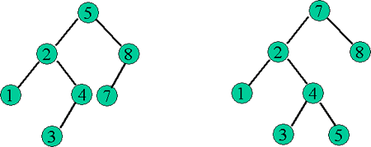
AVL Tree
AVL(adelson-velskii and landis)树是带有平衡条件的二叉查找树。
平衡条件:
  (1)树的深度是 O ( Log N ) , 左右子树具有相同的高度
  (2)每个节点的左子树和右子树的高度最多差1
大致上讲，一个 AVL树的高度最多＝1.44 log( N + 2 ) - 0.328

Slide 66
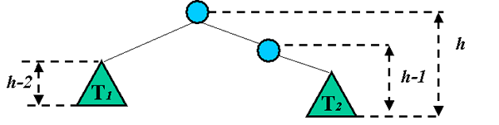
在高度为h的 AVL树中，最少节点数, S ( h ),由 S ( h ) = S ( h - 1 ) + S ( h - 2 ) + 1给出
在插入以后，只有那些从插入点到根节点的路径上的节点的平衡可能被改变，因为只有这些节点的子树可能发生变化。

Slide 67

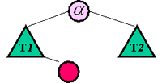
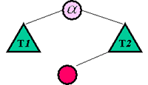
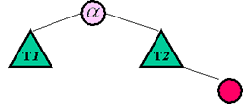
可能找到一个节点，它的新平衡破坏了 AVL 条件。
当我们沿着这条路上行到根并更新平衡信息时, 我们可以找到节点 它的新平衡破坏了 AVL 条件。这种不平衡可能出现在下面四种情况中：
对 的左儿子的左子树进行一次插入 | LL |  | 单旋转
对 的左儿子的右子树进行一次插入 | LR |  | 双旋转
对 的右儿子的左子树进行一次插入 | RL |  | 双旋转
对 的右儿子的右子树进行一次插入 | RR |  | 单旋转

Slide 68
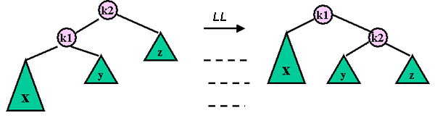
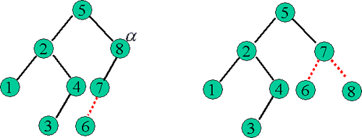
LL

Slide 69
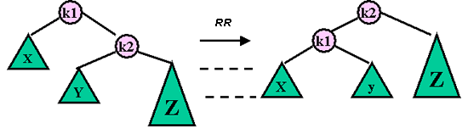
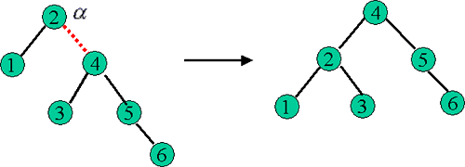
RR

Slide 70
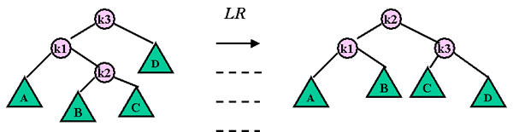
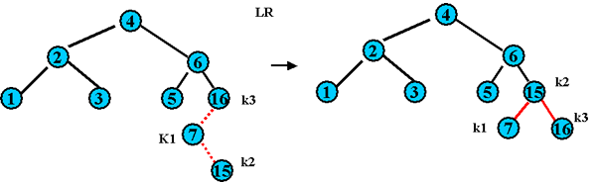
LR

Slide 71
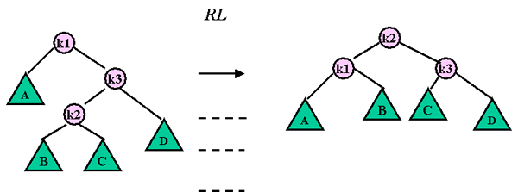
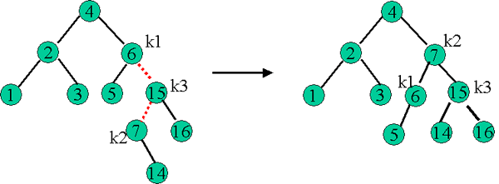
RL

Slide 72
§10.2 AVL Trees
〖Example〗 Input the months
Mar
May
Nov
0
−1
−2
Mar
0
−1
−2
−1
0
0
Single rotation
May
−1
May
0
0
0
0
0
Mar
Nov
Nov
 The trouble maker Nov is in the right subtree’s right subtree of the trouble finder Mar. Hence it is called an RR rotation.
A is not necessarily
the root of the tree
In general:
−2
0
−1
RR
B
A
A
−1
RR
0
0
Insertion
A
B
A_{L}
B
B_{R}
A_{L}
Rotation
B_{L}
B_{R}
A_{L}
B_{L}
B_{L}
B_{R}

Slide 73
§10.2 AVL Trees
Aug
Apr
2
0
−1
−2
−1
1
LL
−1
−2
0
−1
1
May
May
2
Rotation
0
1
0
0
−1
0
1
0
0
0
Mar
Nov
Aug
Nov
1
0
0
0
Aug
Apr
Mar
0
Apr
In general:
1
2
A
LL
A
0
LL
B
0
1
B
Insertion
B
0
A_{R}
A_{R}
Rotation
A
B_{L}
B_{L}
B_{R}
B_{L}
B_{R}
B_{R}
A_{R}

Slide 74
§10.2 AVL Trees
Jan
2
Double Rotation
−1
−2
0
−1
1
0
−1
−2
−1
May
0
−1
Mar
−1
0
1
0
0
0
0
0
−1
0
Aug
Nov
1
−1
1
Aug
May
0
0
Apr
Mar
0
0
0
Apr
Jan
Nov
0
LR
Jan
Rotation
In general:
1
LR
2
LR
A
A
0
0
Insertion
−1
Rotation
C
B
A_{R}
B
0
±1
A_{R}
0 or 1
−1 or 0
C
C
B
A
B_{L}
B_{L}
C_{L}
C_{R}
C_{L}
C_{R}
B_{L}
C_{L}
C_{R}
A_{R}
OR
OR

Slide 75
Dec
July
Feb
§10.2 AVL Trees
−1
−2
0
−1
1
2
Mar
0
−1
−2
−1
RL
1
1
Mar
0
0
−1
−1
−2
Aug
May
Rotation
0
−1
−1
0
0
−1
−2
0
0
Dec
May
1
0
Apr
Jan
0
1
0
1
−1
Nov
0
0
0
Aug
Jan
Nov
−1
0
Dec
July
0
0
0
Apr
Feb
July
0
Feb
In general:
1
RL
−2
RL
A
A
0
0
Insertion
1
Rotation
C
A_{L}
B
B
0
A_{L}
±1
0 or 1
−1 or 0
C
C
A
B
B_{R}
B_{R}
C_{L}
C_{R}
C_{L}
C_{R}
A_{L}
C_{L}
C_{R}
B_{R}
OR
OR

Slide 76
§10.2 AVL Trees
June
Oct
Sept
0
−1
0
−1
−2
−1
1
2
0
−1
Jan
Mar
−1
Jan
−1
1
0
−1
−2
0
0
−1
−1
0
0
−1
−2
−1
−1
−1
1
0
−1
−2
0
Dec
Mar
Dec
Dec
May
Mar
0
1
0
1
−1
0
1
0
−1
−2
−1
−1
1
0
−1
0
Aug
Jan
0
Aug
Feb
July
−1
May
Aug
Feb
July
Nov
0
0
Nov
0
0
−1
−1
Feb
0
0
0
July
−1
Apr
0
0
0
Apr
June
Nov
Apr
June
May
Oct
0
0
June
0
Oct
Sept
Another option is to keep a height field for each node.

Slide 77
§10.2 AVL Trees
AvlTree Insert( ElementType X, AvlTree T )
{ if ( T == NULL ) { /* Create and return a one-node tree */
T = (AvlTree)malloc( sizeof( struct AvlNode ) );
if ( T == NULL ) FatalError( "Out of space!!!" );
else { T->Element = X; T->Height = 1; T->Left = T->Right = NULL; }
} /* End creating a one-node tree */
else if ( X < T->Element ) { /* handle left insertion */
T->Left = Insert( X, T->Left );
if ( Height( T->Left ) - Height( T->Right ) == 2 ) /* not balanced */
if ( X < T->Left->Element ) /* LL Rotation */
T = SingleRotateWithLeft( T );
else /* LR Rotation */
T = DoubleRotateWithLeft( T ); } /* End left */
else if( X > T->Element ) { /* handle right insertion */
T->Right = Insert( X, T->Right );
if ( Height( T->Right ) - Height( T->Left ) == 2 ) /* not balanced */
if ( X > T->Right->Element ) /* RR Rotation */
T = SingleRotateWithRight( T );
else /* RL Rotation */
T = DoubleRotateWithRight( T ); } /* End right */
/* Else X is in the tree already; we'll do nothing */
T->Height = Max( Height( T->Left ), Height( T->Right ) ) + 1;
return T;
}

Slide 78


§10.2 AVL Trees
Let n_{h} be the minimum number of nodes in a height balanced tree of height h. Then the tree must look like
A
A
h−2
One last question:
Obviously we have T_{p} = O( h )
where h is the height of the tree.
But h = ?
h−1
h−1
h−2
OR
⇒ n_{h} = n_{h−1} + n_{h−2} + 1
Fibonacci numbers:
F₀ = 0, F₁ = 1, F_{i} = F_{i−1} + F_{i−2} for i > 1
⇒ n_{h} = F_{h+2} − 1, for h ≥ 0
Fibonacci number theory gives that

Slide 79
Heaps
1. The Heap ADT
【Definition】A max tree is a tree in which the key value in each node is no smaller than the key values in its children (if any). A max heap is a complete binary tree that is also a max tree.
【Definition】A min tree is a tree in which the key value in each node is no larger than the key values in its children (if any). A min heap is a complete binary tree that is also a min tree.
The largest key
The smallest key
[1]
9
[1]
10
[2]
6
[3]
3
[2]
20
[3]
83
[4]
5
[4]
50
A max heap
A min heap

Slide 80
§6 Heaps
structure MaxHeap is
objects: A complete binary tree of n > 0 elements organized so that the values in each node is at least as large as those in its children
functions:
for all heap ∈ MaxHeap, item ∈ Element, and n, max_size ∈ integer
MaxHeap Create ( max_size )
::= creates an empty heap that can hold a maximum of max_size elements.
Boolean HeapFull ( heap, n )
::= if ( n = = max_size ) return TRUE
else return FALSE
MaxHeap Insert ( heap, item, n )
::= if ( !HeapFull ( heap, n ) ) insert item into heap and return the resulting heap
else return error

Slide 81
§6 Heaps
structure MaxHeap is ( continued )
functions:
Boolean HeapEmpty ( heap, n )
::= if ( n > 0 ) return TRUE
else return FALSE
Element Delete ( heap, n )
::= if ( !HeapEmpty ( heap, n ) ) return one instance of the largest element in the heap and remove it from the heap
else return error
end MaxHeap
2. Priority Queues
—— delete the element with the highest \ lowest priority
Obviously we can use max \ min heaps
to represent this kind of queue.
But is it our best choice?

Slide 82
§6 Heaps
Other options of priority queue representation:
 Array :
Insertion — add one item at the end ~ Θ ( 1 )
Deletion — find the largest \ smallest key ~ Θ ( n )
remove the item and shift array ~ O( n )
 Linked List :
Insertion — add to the front of the chain ~ Θ ( 1 )
Deletion — find the largest \ smallest key ~ Θ ( n )
remove the item ~ Θ( 1 )
 Ordered Array :
Insertion — find the proper position ~ O( n )
shift array and add the item ~ O( n )
Deletion — remove the first \ last item ~ Θ( 1 )
 Ordered Linked List :
Insertion — find the proper position ~ O( n )
add the item ~ Θ( 1 )
Deletion — remove the first \ last item ~ Θ( 1 )

Slide 83
The Representation of Heap
如何在C语言中实现Heap的表示？
  数组！
  采用不使用下标为0的数组来表示完全二叉树，具有Lemma 5.3：
    If a complete binary tree with n nodes is represented sequentially, then for any node with index i, 1<=i<=n, we have
      Parent(i) is at [i/2] if I<>1. If i=1, i is at the root and has no parent.
      Left_child(i) is at 2i if ai<=n. If 2i>n, then i has no left child.
      Right_child(i) is at 2i+1 If 2i+1<=n. if 2i+1>n, then i has no right child.

Slide 84
The C declarations for Heap
/*书上的实现方式*/
#ifndef _BinHeap_H
#define _BinHeap_H
struct HeapStruct;
typedef struct HeapStruct *PriorityQueue;
PriorityQueue Initialize( int MaxElements );
void Destroy( PriorityQueue H );
void MakeEmpty( PriorityQueue H );
void Insert( ElementType X, PriorityQueue H );
ElementType DeleteMin( PriorityQueue H );
ElementType FindMin( PriorityQueue H );
int IsEmpty( PriorityQueue H );
int IsFull( PriorityQueue H );
#endif
struct HeapStruct
{
int Capacity;
int Size;
ElementType *Elements;
};
/*简单的实现方式*/
/*maximum heap size + 1 */
#define MAX_ELEMENTS 200
#define HEAP_FULL(n) (n==MAX_ELEMENTS-1)
#define HEAP_EMPTY(n) (!n)
typedef struct {
int key;
}element;
element heap[MAX_ELEMENTS];
int n = 0;
/* the number of nodes in heap */

Slide 85
Heap Initialization
初始化指定堆的大小
PriorityQueue Initialize( int MaxElements )
{
PriorityQueue H;
if( MaxElements < MinPQSize )
Error( "Priority queue size is too small" );
H = malloc( sizeof( struct HeapStruct ) );
if( H ==NULL )
FatalError( "Out of space!!!" );
/*Allocate the array plus one extra for sentinel */
H->Elements = malloc( ( MaxElements + 1 )
* sizeof( ElementType ) );
if( H->Elements == NULL )
FatalError( "Out of space!!!" );
H->Capacity = MaxElements;
H->Size = 0;
H->Elements[ 0 ] = MinData;
return H;
}
建立堆结构变量 H
申请数组空间
初始化数组容量值Capacity
最初未放一个元素size=0
堆数组中，第0个元素不用

Slide 86
Insert into a Max Heap
An example
(a) heap before
insertion
[1]
20
(c) Insert 5 into
Heap (a)
[1]
20
15
2
[2]
15
[3]
5
[2]
[3]
14
10
14
10
2
[4]
[5]
[4]
[5]
[6]
(b) Initial location
Of new node
[1]
20
(b) Insert 21 into
Heap (a)
[1]
21
[2]
15
[3]
2
15
20
[2]
[3]
14
10
14
10
2
[4]
[5]
[6]
[4]
[5]
[6]

Slide 87
The function insert_min_heap
void insert (ElementType X, PriorityQueue H)
{
/* insert item into a min heap of current size *n */
int i;
if ( IsFull( H ))
{
Error( "Priority queue is full" );
return;
}
i = ++H->Size;
while (( i != 1) && ( H->Elements[ i / 2 ] > X ))
{
H->Elements[ i ] = H->Elements[ i / 2 ];
i /= 2;
}
H->Elements[ i ] = X;
}
Analysis of insert_max_heap:
The size of new heap is n+1
We follows a path from the new leaf to the root
The height of the complete binary tree with n elements is [log₂(n+1)].
Hence, the complexity is O(log₂n).
Notes:
（1）判断HEAP是否为空
（2）新结点在数组中的位置就是当前的N加1
（3）从新结点沿着到根结点的路径向上移动
（4）若当要插入的结点的KEY大于父结点的KEY，则交换父结点和子结点
（5）直到（a）父结点的KEY大于要插入结点的KEY
（b）遇到根结点
（6）注意程序中直到最后才实现值的交换！（节省时间）

Slide 88
Deletion from a Max Heap
An Example
20 removed
[1]
[1]
10
[1]
15
[2]
15
[3]
2
[2]
15
[3]
2
[2]
14
[3]
2
14
10
14
10
[4]
[5]
[4]
[4]
(a) heap structure
(b) 10 insert at the root
(c) Final heap
Notes:
（1）总是从HEAP的根结点取元素
（2）在取走元素后，必须重建HEAP－－－－－－》树的形状不正确
（3）将最后的结点放入根结点－－－－－－－－－》树的形状正确了
（4）从根结点开始向下移动（moving down the heap）
比较（compare the parent node with its children）父结点与子结点（两个子结点中的大的一个）的KEY，
并交换（exchange out-of-order elements）顺序不正确的元素，直到HEAP建立完。

Slide 89
The function delete_min_heap
ElementType DeleteMin( PriorityQueue H )
{
int i, Child; ElementType MinElement, LastElement;
if( IsEmpty( H ) )
{
Error( "Priority queue is empty" ); return H->Elements[ 0 ];
}
MinElement = H->Elements[ 1 ]; LastElement = H->Elements[ H->Size-- ];
for( i = 1; i * 2 <= H->Size; i = Child )
{
/* Find smaller child */
Child = i * 2;
if( Child != H->Size && H->Elements[ Child + 1 ] < H->Elements[ Child ] )
Child++;
/* Percolate one level */
if( LastElement > H->Elements[ Child ] )
H->Elements[ i ] = H->Elements[ Child ];
else
break;
}
H->Elements[ i ] = LastElement; return MinElement;
}
找到当前父结点的最小子女结点
将最小的子女结点放入父结点
若满足HEAP的条件，则退出

Slide 90
Other Heap operations
 | MinHeap is no help to find the maximum element
 | the maximum element is that it is at one of the leaves. ( half the element )
 | if we want to know where element are, some other data structure, such as a hash table, must be used in addition to the help.
 | if we assume that the position of every element is known by some other method, then several other operations become cheap ( O (log N ))
DecreaseKey | Decreasekey( P, , H) operation lowers the value of the key at position P by a positive amount (Percolate up)
useful to system administrators, They can make up their programming run with highest priority
IncreaseKey | Increasekey( P, , H) operation increase the value of the key at position P by a positive amount (Percolate down)
many schedulers automatically drop the priority of process that is consuming excessive CPU time.
Delete | Delete( P, H ) operation removes the node at position P from the heap. First performing Decreasekey( P, , H), and then performing DeleteMin (H )
BuildHeap | BuildHeap( H ) operation takes as input N keys and places them into an empty heap. N successive inserts.
 | Since each insert will take O(1 ) average and O ( log N ) worst-case time, total running time of this algorithm would be O(N ) average but O (N log N ) worst-case.

Slide 91
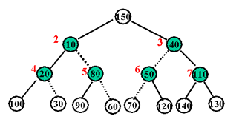
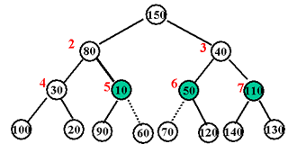
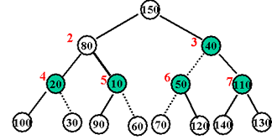
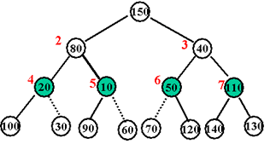
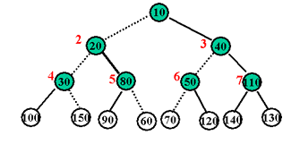
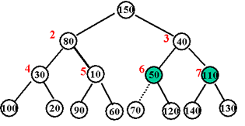
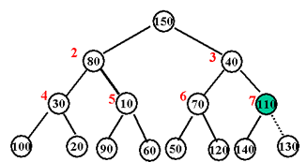
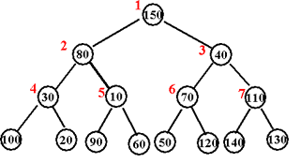
Buildheap
The general algorithm is to place the N keys into the tree in any order, maintaining the structure property.
for ( i = N / 2 ; i > 0 ; i -- )
PercolateDown ( i );
theorem | For the perfect binary tree of height h containing - 1 nodes, the sum of the heights of the nodes is - 1 - ( h - 1 )
 | A complete tree is not a perfect binary tree ( bound ) O ( N )

Slide 92
Applications of Priority Queue
selection problem | find the kth smallest element
Algorithm 6A | Finding the kth smallest element. Read the N elements into an array. Apply the buildheap algorithm to this array. Perform k DeleteMin operations. The last element extracted from the heap is our answer.
 | Worst-case timing is O( N ) to construct the heap, O (log N ) for each DeleteMin a total running time of O (N + klog N ), k = O ( N / logN) Then the running tine is O( N ) For larger values of k, the running time is O (klog N ). If k = N /2 then the running time is (N log N )
selection problem | find the kth largest element
Algorithm 6B | Maintain a set S of the k largest elements. After the first k elements are read , ( use a heap to implement S ), when a new element is read it is compared with the kth largest element,
 | the first k elements are placed into the heap in total time O(k ) with a call to buildheap. To test if the element goes into S, time O (log k ), to delete Sk and insert the new element if this is necessary. Thus, the total time is O ( k + ( N - k ) log k ) = O (N log k), (N log N ) In chapter 7, O( N ) worst-case time, in chapter 10, O( N ) worst-case time,

Slide 93
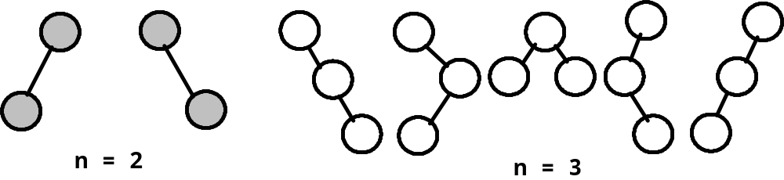
Counting binary tree
As the conclusion of this chapter, considering following questions:
  Distinct Binary Trees:
    How many distinct binary trees are there with n nodes?

Slide 94
Distinct binary trees
如果n=0，1，则只有一棵二叉树
如果n=2，则有两棵二叉树
如果n=3，则有5种二叉树
那么，n个结点的树有几种二叉树形态呢？
在得出结论之前，先来回答开始的第（2），（3）个问题。

Slide 95
  Stack Permutations
Given a preorder sequence, e.g., ABCDEFGHI, the corresponding binary trees are not unique.
If the corresponding inorder sequence is given as well, e.g., BCAEDGHFI, then can we uniquely define a binary tree?
Yes!
A
Fix a preorder sequence
1, 2, 3, ..., n
The number of distinct
binary trees is
the number of distinct
inorder permutations.
BC
B
EDGHFI
D
C
E
F
GHFI
GH
I
G
H

Slide 96
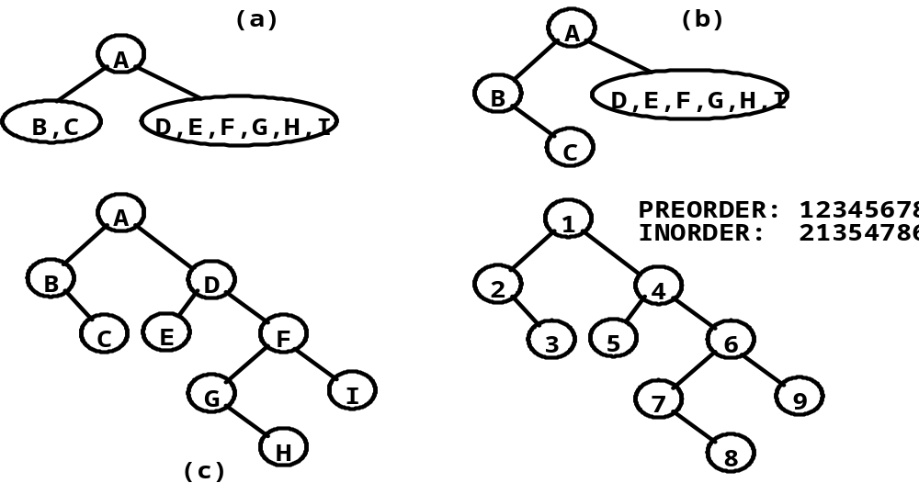
An Example
Every binary tree has
a unique pair of preorder-inorder sequence !

Slide 97
Inorder permutation is also equivalent to passing the numbers 1 to n through a stack and deleting in all possible ways.
〖Example〗 Given the preorder sequence 1, 2, 3.
1
1
2
1
1
2
3
2
3
1
3
2
2
1
2
3
1
2
3
3
3
4
1
1
2
2
1
3
2
2
3
1
3
2
1
3
2
3
1
3
5
1
Note: It is impossible to obtain 3, 1, 2
3
2
3
2
1
2
1
1
3
3
2

Slide 98

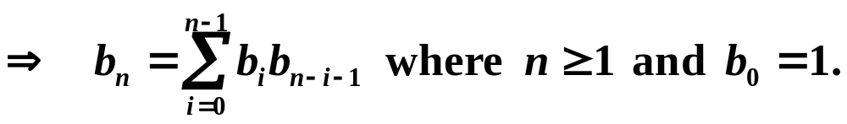
3. Matrix Multiplication: M₁⋅ M₂⋅ ⋅ ⋅ ⋅ M_{n}
Let b_{n} = number of different ways to compute M₁⋅ M₂⋅ ⋅ ⋅ ⋅ M_{n}. Then we have b₂ = 1, b₃ = 2, b₄ = 5, ⋅ ⋅ ⋅
Let M_{ij} = M_{i}⋅ ⋅ ⋅ ⋅ M_{j} . Then M_{1n} = M₁⋅ ⋅ ⋅ ⋅ M_{n} = M_{1i} ⋅ M_{i+1 n}
b_{n}
b_{i}
b_{n−i}
Note: If we let b_{n} = number of distinct binary trees with n nodes, then similarly we have
BT = root + subtree with i nodes + subtree with n−i −1 nodes
b_{n}
b_{i}
b_{n−i−1}
The above 3 problems are equivalent

Slide 99
Matrix Multiplication
假设我们希望计算m个矩阵的乘积：
M1 * M2 * … * Mn
既然矩阵乘法符合结合律，我们可以按照任意次序实现乘法。我们希望知道可以有多少种方式来实现乘法。比如，如果n=3，则有两种可能性：
（M1 * M2） * M3
M1 * （M2 * M3）
如果n=4，则有5种可能性：
（（M1 * M2） * M3） * M4
（M1 * （M2 * M3））* M4
M1 * （（M2 * M3） * M4）
（M1 * （M2 * （M3 * M4）））
（（M1 * M2） * （M3 * M4））

Slide 100
Matrix Multiplication
设b_{n}为计算n矩阵乘积的不同方法数。则b₂=1，b₃=2，b₄=5。设M_{ij}，i<j,为M_{i}*M_{i+1}*…*M_{j}的乘积。要计算M_{1n}，可以通过计算M_{1i} * M_{i+1}的任意乘积。获得M_{1i}和M_{i+1}的不同方法数分别为b_{i}和b_{n-i}。因此，设b₁=1，有：
n-1
b_{n} = ∑ b_{i}b_{n-i}， n>1
i=1
如果可以仅仅通过n来决定b_{n}的表达式，则我们可以得到问题的解决方法。
现在令b_{n}为n个结点能组成的不同二叉树的数目。可见，b_{n}为按照以下方式所得到的不同二叉树的总数：有b₁和b_{n-i-1}个结点的一个ROOT和两个子树：
n-1
b_{n} = ∑ b_{i}b_{n-i-1}， n>=1，b₀=1
i=0
该式与前式基本相同，因此有n个结点构成的二叉树的数目，通过堆栈得到的从1到n的排列数目，以及n+1个矩阵相乘的方法数目均相等。

Slide 101
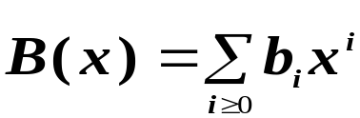

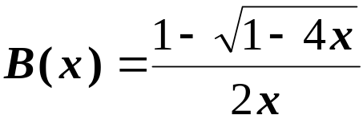

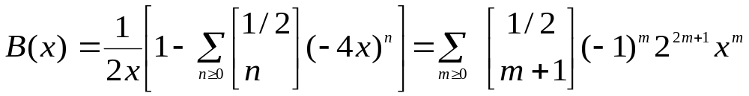

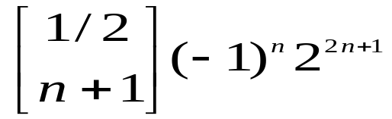
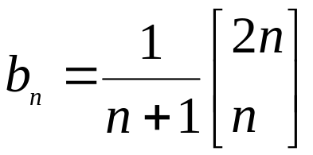

Number of distinct binary trees
to obtain the number of distinct binary tree with n nodes, we must solve the recurrence of Eq.(1). we let
Eq.(1).
using the formula to solve quadratics and the fact that b(0) = b 0 = 1 we get:
Eq.(2)
using the binomial theorem to expand to obtain:
Eq.(3)
comparing Eq.(2) and Eq.(3) we see that b_{n}, which is the coefficient of in B(x), is:

Slide 102
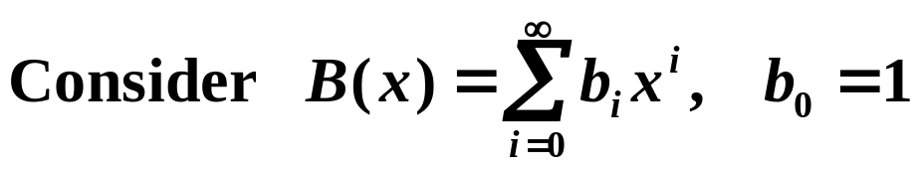
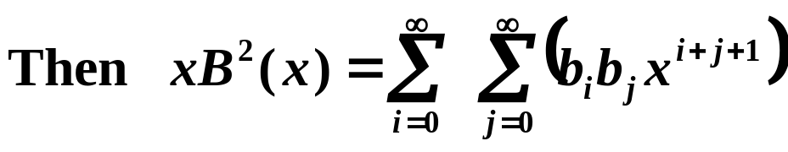
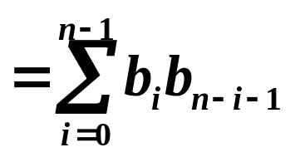
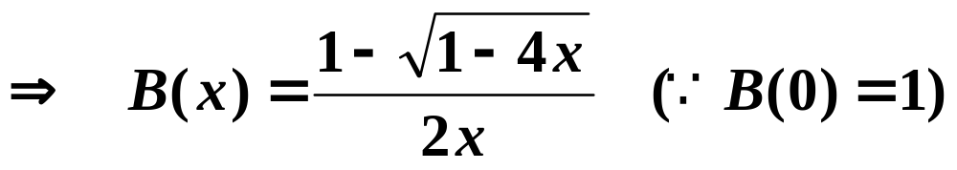
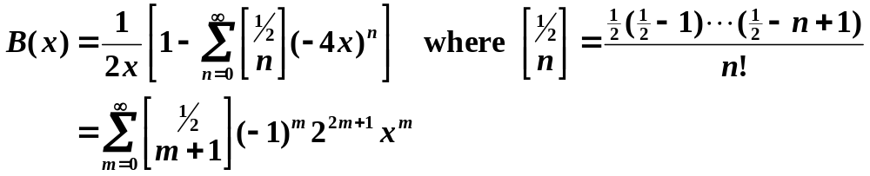
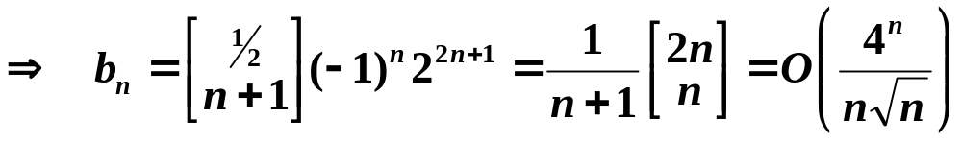
4. Number of Distinct Binary Trees: b_{n} = ?
The coefficient of x^{n} in xB²( x )
The coefficient of x^{n} in B( x ) = b_{n}
∴ xB²( x ) = B( x ) − 1

